Slide 1
Department of Computer Science & Engineering
I Year CSE II Sem
Subject: Adaptive Computer Technologies(MR22-1ES0103)
Prepared by
Vikram Kalvala
Asst.Prof.

Slide 2
Unit 2- Internet
Internet: History, Internet Protocol Address, Types of IP Addresses, Domain Name System (DNS), Uniform Resource Locator (URL)
Internet Services: Electronic Mail, File Transfer Protocol, Chatting, Internet Conferencing, Electronic Newspaper, World Wide Web, Online Shopping, Search Engine
Web Security terminology: Virus, Malware, Ransom ware, Trojan Horse, Worm, Bot/Botnet, Spy ware, Rootkit, DDos, Phishing, Click jacking, Deep fake, White hat/Black hat, Firewall, Encryption, Decryption, Penetration testing.
Casestudy-2: Create a Poster/PPT about the differences between website and web portal

Slide 3
History of Internet
The Internet started in the 1960s as a way for government researchers to share information.
Reasons: 1. Computers in the '60s were large and immobile- travel to computer site or magnetic tapes send through the conventional postal system.
2. The Cold War. The Soviet Union's Sputnik satellite spurred the U.S. Defense Department to consider ways information could still be disseminated even after a nuclear attack.
This lead to formation of the ARPANET (Advanced Research Projects Agency Network), a big success and evolved as internet.
But access limited to academic and research organizations who had contracts with the Defense Department.
Other networks were created to provide information sharing.
January 1, 1983 is considered the official birthday of the Internet.
Prior to this, the various computer networks did not have a standard way to communicate with each other.

Slide 4
History of Internet
A new communications protocol called Transfer Control Protocol/Internetwork Protocol (TCP/IP) was established that allowed different kinds of computers on different networks to "talk" to each other.
ARPANET and the Defense Data Network officially changed to the TCP/IP standard on January 1, 1983, hence the birth of the Internet.
All networks could now be connected by a universal language.
https://www.usg.edu/galileo/skills/unit07/internet07_02.phtml

Slide 5
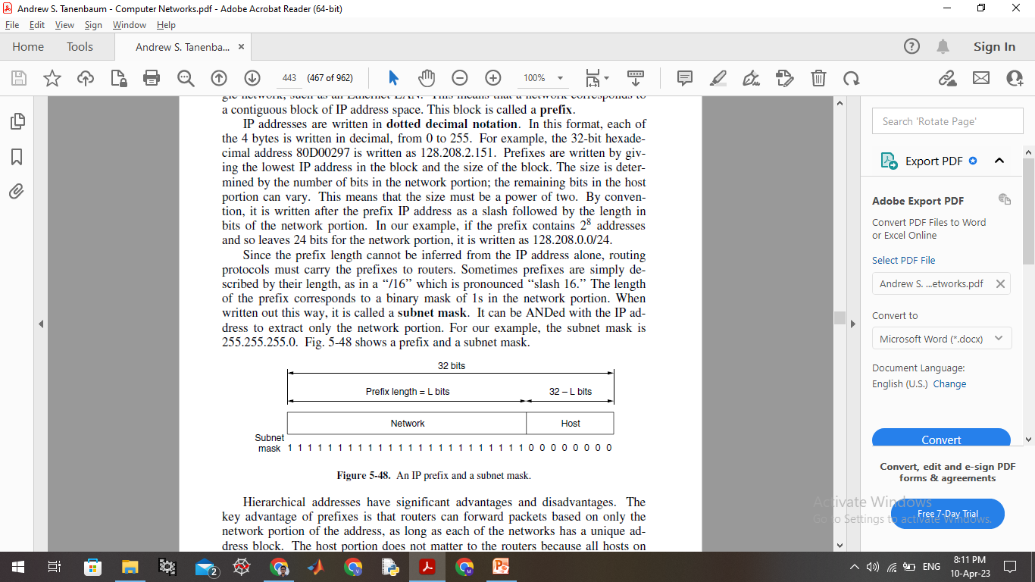
Internet Protocol (IP) Address
Def:
The glue that holds the whole Internet together is the network layer protocol, IP (Internet Protocol).
IP stands for "Internet Protocol," a set of rules governing the format of data sent via the internet or local network.
Its job to transport packets from source to destination in same network or in other networks.
In essence, IP addresses are the identifier that allows information to be sent between devices on a network: they contain location information and make devices accessible for communication.
IP address differentiate between different computers, routers, and websites to ease the working of internet.

Slide 6
Internet Protocol (IP) Address
What is it:
An IP address is a string of numbers separated by periods, expressed as a set of four numbers, represented by 32 bits for IPV4 address.
Eg. 192.158.1.38. Each number in the set can range from 0 to 255.
So, the full IP addressing range goes from 0.0.0.0 to 255.255.255.255.
IP addresses are not random.
They are mathematically produced and allocated a division of the Internet Corporation for Assigned Names and Numbers (ICANN).
Each time anyone registers a domain on the internet, they go through a domain name registrar, who pays a small fee to ICANN to register the domain.
How it works:
IP works the same way as any other language, by communicating using set guidelines to pass information.
All devices find, send, and exchange information with other connected devices using this protocol.

Slide 7
Internet Protocol (IP) Address
Your device indirectly connects to the internet by connecting at first to a network connected to the internet, which then grants your device access to the internet.
At Home- Internet Service Provider (ISP) & At work- company network.
Your IP address is assigned to your device by your ISP.
Your internet activity goes through the ISP, and they route it back to you, using your IP address. Since they are giving you access to the internet, it is their role to assign an IP address to your device.
However, your IP address can change. Eg: turning your modem or router on or off can change it. Or you can contact your ISP, and they can change it for you.
When you are out –your home IP address does not come with you. This is because you will be using another network at hotel or airport- a temporary IP address will be given by that.

Slide 8
Types of Internet Protocol (IP) Address
Private IP addresses:
Each device connected to a home network or a private network carries a private IP address.
Private IP addresses are non-internet facing and are only used on an internal network.
Devices with private IP addresses might include computers, tablets, smartphones, Bluetooth devices, smart TVs and printers.
With the increasing popularity of internet of things products, the use of private IP addressing is likely to keep growing.
Public IP addresses:
An ISP assigns these addresses, which enable a router to communicate with the internet or an outside network.
Public IP addresses cover the entire network, meaning multiple devices sharing the same internet connection will also share the same public IP address.

Slide 9
Types of Internet Protocol (IP) Address
Dynamic IP addresses:
Constantly changing and a new dynamic IP address is assigned to a device every time it connects to the internet.
ISPs buy large pools of IP addresses to assign, revolve and reuse between different customers for cost savings and easier management.
It also offers security benefits, as it's harder for cybercriminals to hack into a network interface if its IP is constantly changing.
Static IP addresses:
They never change once assigned by the network.
Requirement for businesses that wish to host their own web servers.
A static IP address ensures that all websites and email addresses associated with a certain web server will always have a consistent IP address so it can be reached on the internet.

Slide 10
Types of Internet Protocol (IP) Address
Website IP addresses:
IP addresses for website owners who rely on a hosting company for servers. 2 types:
Shared: IP address is shared among many different websites and is mostly used by small businesses that use a managed hosting service, such as WordPress.
Dedicated. This is a unique IP address assigned to an individual website. Helps avoid getting blocked or blacklisted, unlike shared IP addresses when malicious behavior is exhibited by other websites sharing the same IP. Owners of dedicated IP addresses can access their websites while waiting for a domain transfer.

Slide 11
Domain Name System (DNS)
Prelude:- At application layer
Remembering IP address of a website (device machine address which they are stored) is difficult.
Also IP address changes when the storage machine changes and need to be informed to every user.
Hence high level reliable names introduced such as www.mallareddyuniversity.ac.in, to be converted to numerical address as machine understand that format only.
----------------------------------------------------------------------------------------
DNS is required for the functioning of the internet.
DNS is a TCP/IP protocol used on different platforms.
It is a directory service that provides a mapping between the name of a host on the network and its numerical address (IP address).
DNS is a service that translates the domain name into IP addresses. This allows the users of networks to utilize user-friendly names when looking for other hosts instead of remembering the IP addresses.

Slide 12
Domain Name System (DNS)
Naming in postal system: the country, state or province, city, street address, and name of the addressee.
Similarly, DNS is a tree like structure, each node in a tree has a domain name, and a full domain name is a sequence of symbols specified by dots. 132.147.165.50.
Each node in the tree has a domain name and a full domain name is a sequence of labels separated by dots (.).
The domain names are always read from the node up to the root.
The last label is the label of the root (null). This means that a full domain name always ends in a null label, which means the last character is a dot because the null string is nothing.
The domain name space is divided into three different sections: Generic domains, country domains, and inverse domain.

Slide 13
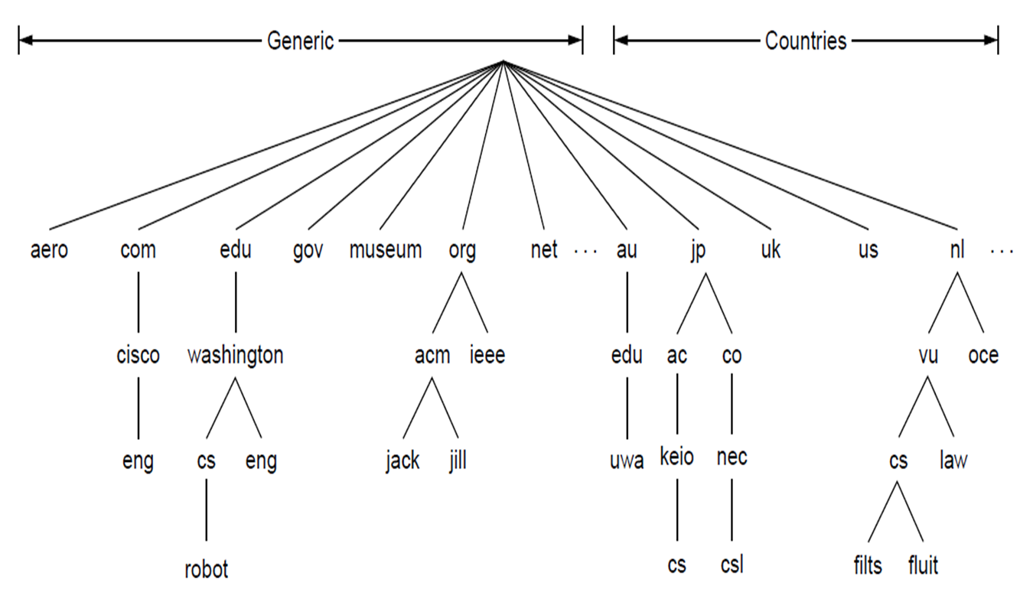
Domain Name System (DNS)

Slide 14
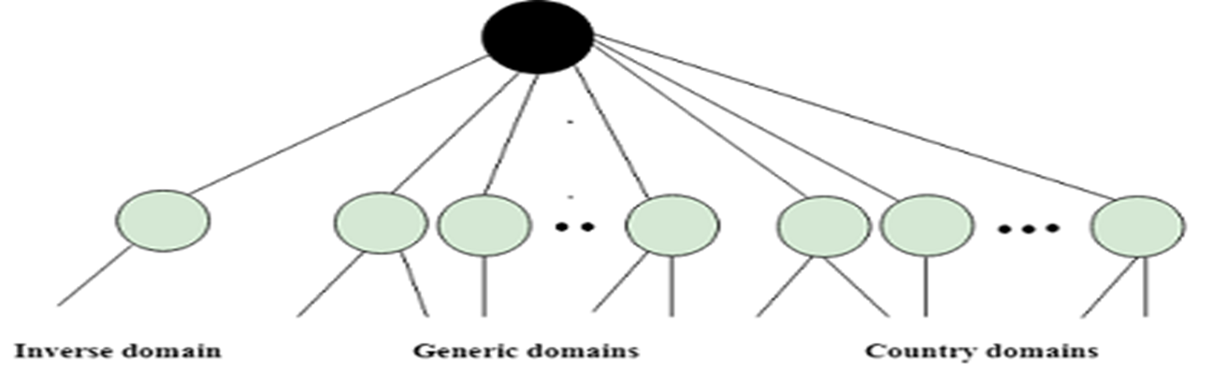
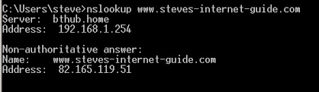
Domain Name System (DNS)
Generic domain:.com:(commercial).edu(educational) .mil(military) .org(non profit organization) .net(similar to commercial) all these are generic domain.
Country domain: .in (India) .us(united states) .uk
Inverse domain: if we want to know what is the domain name of the website. Ip to domain name mapping. So DNS can provide both the mapping for example to find the ip addresses of geeksforgeeks.org then we have to type nslookup www.stevesinternetguide.com

Slide 15
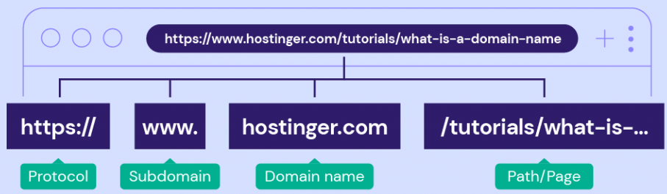
Uniform Resource Locator (URL)
A URL, short for a uniform resource locator is a web address pointing to a specific website, a web page, or a document on the internet.
Eg: https://www.geeksforgeeks.org/url-full-form/
Protocol:
HTTP (Hypertext Transfer Protocol) and HTTPS (Hypertext Transfer Protocol Secure) are network communication protocols between web servers and web browsers.
They transmit messages, retrieve information through the domain name system (DNS), and return it to the browser.
HTTPS encrypts the data transmission process as a security protocol, protects a website better and improve search results rankings.

Slide 16
Uniform Resource Locator (URL)
Subdomain:
A subdomain consists of any words or phrases that come before a URL’s first dot.
www is the most common type. It indicates that a website is accessible through the internet and uses HTTP to communicate.
Other popular options are “blog” and “news.”
Domain name:
A domain name is what users type into their browser’s address bar to reach a website.
It consists of a site name and an extension, for example, hostinger.com.
Every name is unique, and they represent their corresponding IP addresses.
This unique IP address points to the website’s server. In other words, it helps users access websites easily.

Slide 17
Uniform Resource Locator (URL)
Domain extensions:
Also called a top-level domain (TLD). Types:
Generic TLD (gTLD). popular extensions, Eg. .com, .org, .net.
Country Code TLD (ccTLD). country, a territory, or a geographical area. ccTLD consists of two letters based on the international country codes, such as .uk, .in, and .sg.
Sponsored TLD (sTLD). sponsored and used for specific organizations. Eg. Tralliance Registry Management Company, LLC sponsors .travel, and DotAsia Organization Ltd. sponsors .asia.
New gTLD (nTLD). new generation of domain extensions. Basically, any TLD launched after 12 January 2012 are new gTLD, including .online, .store, and .tech.

Slide 18
Uniform Resource Locator (URL)
Path to the Resource:
A path to the resource is the part to the right of the TLD, referred to as the folder structure of the website.
A path to the resource gives extra information to a web server, enabling it to lead users to a specific location. A series of paths to resources may point to a specific page, post, or file.
A URL can have more than one path to resources. When that happens, the forward-slash sign (/) will separate each of them. The more paths to resources a URL contains, the more specific the location is.

Slide 19
Chapter 2- Internet
Internet Services:
Electronic Mail
File Transfer Protocol
Chatting
Internet Conferencing
Electronic Newspaper
World Wide Web
Online Shopping
Search Engine

Slide 20
Internet Services
Electronic Mail(E-Mail):
Defined as the transmission of messages on the Internet.
It is one of the most commonly used features over communications networks that may contain text, files, images, or other attachments.
Generally, it is information that is stored on a computer sent through a network to a specified individual or group of individuals.
This service allows an Internet user to send a message in formatted manner (mail) to the other Internet user in any part of world.
Email messages are conveyed through email servers; it uses multiple protocols within the TCP/IP suite.
Eg: SMTP is a protocol, stands for simple mail transfer protocol and used to send messages whereas other protocols IMAP or POP are used to retrieve messages from a mail server.
If you want to login to your mail account, you just need to enter a valid email address, password, and the mail servers used to send and receive messages.

Slide 21
Internet Services
Although most of the webmail servers automatically configure your mail account.
Microsoft Outlook or Apple Mail require manual configuration.
Components of E-Mail System: User Agent (UA), Message Transfer Agent (MTA), Mail Box, and Spool file.
User Agent (UA):Program used to send and receive mail, also called as mail reader. It accepts variety of commands for composing, receiving and replying to messages as well as for manipulation of the mailboxes.
Message Transfer Agent (MTA):Responsible for transfer of mail from one system to another. To send a mail, a system must have client MTA and system MTA. It transfer mail to mailboxes of recipients if they are connected in the same machine. It delivers mail to peer MTA if destination mailbox is in another machine. The delivery from one MTA to another MTA is done by Simple Mail Transfer Protocol.

Slide 22
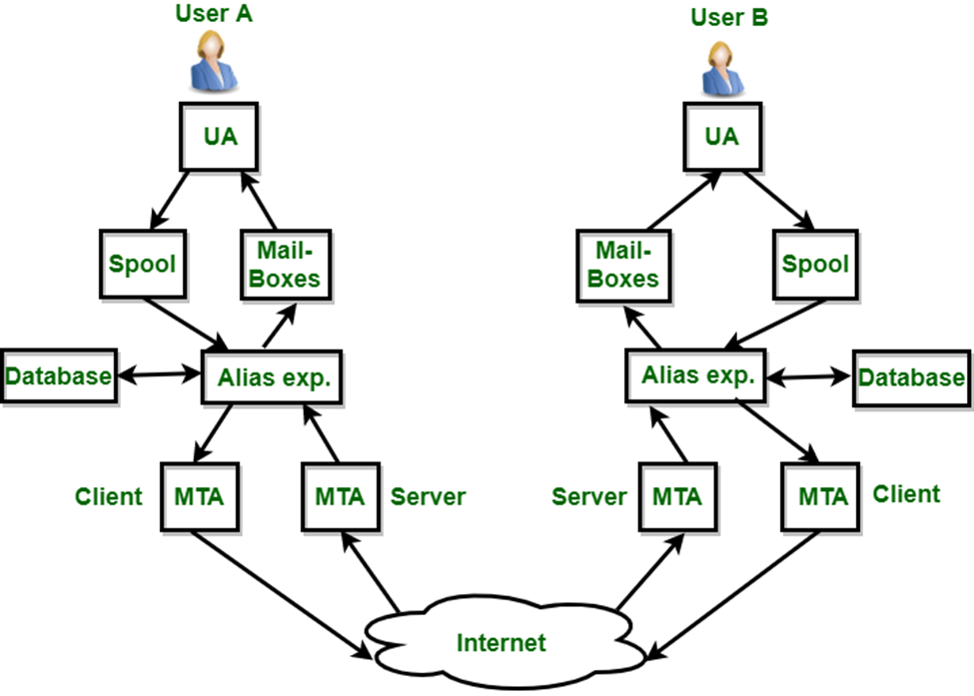
Internet Services
Mailbox: It is a file on local hard drive to collect mails. Delivered mails are present in this file. The user can read it delete it according to his/her requirement. To use e-mail system each user must have a mailbox . Access to mailbox is only to owner of mailbox.
Spool file: This file contains mails that are to be sent. User agent appends outgoing mails in this file using SMTP. MTA extracts pending mail from spool file for their delivery. E-mail allows one name, an alias, to represent several different e-mail addresses. It is known as mailing list, Whenever user have to sent a message, system checks recipient’s name against alias database. If mailing list is present for defined alias, separate messages, one for each entry in the list, must be prepared and handed to MTA. If for defined alias, there is no such mailing list is present, name itself becomes naming address and a single message is delivered to mail transfer entity.

Slide 23
Internet Services
Services provided by E-mail system :
Composition – The composition refer to process that creates messages and answers. For composition any kind of text editor can be used.
Transfer – Transfer means sending procedure of mail i.e. from the sender to recipient.
Reporting – Reporting refers to confirmation for delivery of mail. It help user to check whether their mail is delivered, lost or rejected.
Displaying – It refers to present mail in form that is understand by the user.
Disposition – This step concern with recipient that what will recipient do after receiving mail i.e., save mail, delete before reading or delete after reading.

Slide 24
Internet Services
File Transfer Protocol (FTP):
FTP is an application layer protocol that moves files between local and remote file systems.
FTP is a standard internet protocol provided by TCP/IP.
Used for transferring the web page files from creator to the sever for other computers on the internet.
Also used for downloading the files to computer from other servers.
Although transferring files is very simple and straightforward, but sometimes it can cause problems.
Eg: Two systems may have different file conventions, different ways of representation, operating systems, directories, structures, character sets etc.
FTP protocol overcomes these problems by establishing two connections between hosts. One connection is used for data transfer, and another connection is used for the control connection.

Slide 25
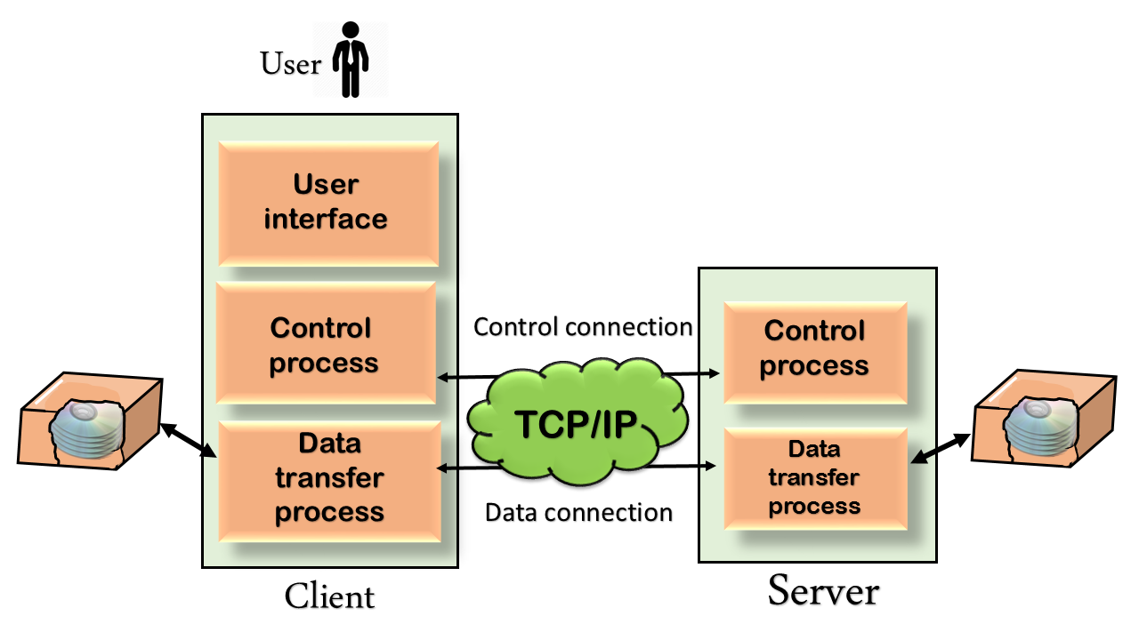
Internet Services
In the FTP, client has three components: the user interface, control process, and data transfer process. The server has two components: the server control process and the server data transfer process.
Control Connection: Uses very simple rules for communication. Through this, we can transfer a line of command or line of response at a time. The control connection is made between the control processes. The control connection remains connected during the entire interactive FTP session.
Data Connection: It uses very complex rules as data types may vary. The data connection is made between data transfer processes. The data connection opens when a command comes for transferring the files and closes when the file is transferred.
https://www.javatpoint.com/computer-network-ftp#:~:text=FTP%20stands%20for%20File%20transfer,other%20computers%20on%20the%20internet.

Slide 26
Internet Services
Chatting:
While the term chatting or chitchat refers in general to communication between two or more parties that can occur in person, in today's modern age, it can also occur over the internet via Short Message Service (SMS) text message and Multimedia Messaging Service (MMS) or, for example, through tools like Slack and Microsoft Teams and social media platforms like Face book and Twitter.
On the internet, the definition of chat refers to talking to other people who are using the internet at the same time you are.
Usually, this talking is the exchange of typed-in messages requiring one site as the repository for the messages -- or chat site -- and a group of users who take part from anywhere on the internet.

Slide 27
Internet Services
Internet Conferencing:
Web conferencing is an online service that allows you to hold live meetings, conferencing, presentations and training via the internet particularly on TCP/IP connections. You can connect to the conference either by telephone or using your computer's speakers and microphone through a VoIP connection.
Broadly, web conferencing provides an online meeting, webcast and webinar solution. It can also be a platform to host online events.
Features line: screen sharing, instant messaging, desktop sharing, remote control, file sharing, an interactive whiteboard and additional features.
Some will also allow users to schedule meetings and send automatic invitations to attendees. Additionally, web conferencing technologies can be part of a unified communication system and typically, businesses will save more having integrated web conferencing tools.

Slide 28
Internet Services
5 Forms of Web conferencing
1. Webinars: Seminars held online, where presenters can have document sharing options. Attendees can comment or ask questions.
2 . Webcast: Online conference that is comparable to a TV broadcast. little or no interaction between the presenter and the participants.
3. Web Meeting: Virtual meetings that encourage interaction amongst the participants. They include collaboration tools like sharing documents, photos or videos and chat tools.
4. Online Collaboration: Participants can view shared files in order to collaborate on modifications that can be done in real-time during the online collaboration. For example, this gives remote access to remote employees to work efficiently on team projects.
5. Online Presentations: Slideshows, powerpoint presentations, streaming audio or video and chat functions are used for online presentations. However, in order for participants to view these presentations they must log in to the online meeting and then they are allowed to interact with the presenter too.

Slide 29
Internet Services
Electronic Newspaper:
E-Newspapers are newspapers which are published electronically. They can take the form of normal print publications published on the Internet; additional or complimentary content to print publications published on-line; or original publications published exclusively on the World Wide Web.
Many news organizations require subscription to e-newspapers, just like regular print newspapers.
E-newspapers run the gauntlet of newspapers, from serious hard news, to features, to arts and entertainment, to sports, and everything in between.

Slide 30
Internet Services
World wide web:
WWW is commonly known as the web. The WWW was initiated by CERN (European library for Nuclear Research) in 1989.
WWW is the collection of different websites around the world, containing different information shared via local servers (or computers).
History:
It is a project created, by Timothy Berner Lee in 1989, for researchers to work together effectively at CERN. is an organization, named the World Wide Web Consortium (W3C), which was developed for further development of the web. This organization is directed by Tim Berner’s Lee, aka the father of the web.
Features of WWW: HyperText Information System, Cross-Platform, Distributed, Open Standards and Open Source, Uses Web Browsers to provide a single interface for many services, Dynamic, Interactive and Evolving and “Web 2.0”

Slide 31
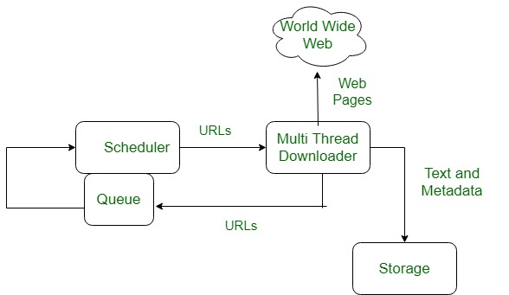
Internet Services
WWW System Architecture:
From the user’s point of view, the web consists of a vast, worldwide connection of documents or web pages.
Each page may contain links to other pages anywhere in the world. The pages can be retrieved and viewed by using browsers of which internet explorer, Netscape Navigator, Google Chrome.
The browser fetches the page requested interprets the text and formatting commands on it, and displays the page, properly formatted, on the screen.
Here the browser is displaying a web page on the client machine. When the user clicks on a line of text that is linked to a page on the abd.com server, the browser follows the hyperlink by sending a message to the abd.com server asking it for the page.

Slide 32
Internet Services
Working of WWW:
The World Wide Web is based on several different technologies: Web browsers, Hypertext Markup Language (HTML) and Hypertext Transfer Protocol (HTTP).
A Web browser is used to access web pages.
Web browsers can be defined as programs which display text, data, pictures, animation and video on the Internet.
Hyperlinked resources on the WWW can be accessed using software interfaces provided by Web browsers.
Initially, Web browsers were used only for surfing the Web but now they have become more universal.
Web browsers can be used for several tasks including conducting searches, mailing, transferring files, and much more. Some of the commonly used browsers are Internet Explorer, Opera Mini, and Google Chrome.

Slide 33
Internet Services
Components of WEB:
Uniform Resource Locator (URL): serves as a system for resources on the web.
HyperText Transfer Protocol (HTTP): specifies communication of browser and server.
Hyper Text Markup Language (HTML): defines the structure, organisation and content of a webpage.

Slide 34
Internet Services
Online Shopping:
Electronic commerce, refers to the buying and selling of goods and services over the internet.
It involves electronic platforms like websites, mobile applications, and social media, to conduct transactions between businesses and consumers or between businesses.
E-commerce has revolutionized the way businesses operate and has created new opportunities for entrepreneurs and consumers alike.
Primary benefits is that it offers a more convenient and efficient way to conduct business.
Consumers can browse and purchase products from the comfort of their own homes, while businesses can reach a global audience without the need for a physical storefront.
E-commerce has also enabled businesses to streamline their operations by automating many of the tasks involved in the sales process, such as inventory management, order processing, and shipping.

Slide 35
Internet Services
Types of E-commerce model:
Business to Consumer (B2C): When a good or service is sold to an individual consumer by a business, e.g., shoes from an online retailer.
Business to Business (B2B): When a good or service is sold by a business to another business, e.g., a software-as-a-service is sold by a business for other businesses to use.
Consumer to Consumer (C2C): When a good or service is sold by a consumer to another consumer, e.g., eBay.
Consumer to Business (C2B): When a consumer’s own products or services is sold to a business or organization, e.g., an authority offers exposure to their online audience in exchange for a fee or a photographer licenses their photo for a business to use.
Business-to-government(B2G): businesses sell products or services to government agencies through online portals or marketplaces.
Government-to-business (G2B): Government agencies sell products or services to businesses through online portals.

Slide 36
Internet Services
Government-to-consumer(G2C): Government agencies provide products or services directly to consumers through online portals.
Advantages of E-commerce:
E-commerce enables fast and secure shopping.
It is making digitalized world.
E-commerce also enables to choose different goods and services according to your choice.
It is a simple way of selling and buying products and services.
E-commerce replaced the paper work as all transactions are through internet today.
It provides better management system, as it has a centralized database.
E-commerce via internet covers a large number of customers worldwide.
E-commerce has several payment modes.

Slide 37
Internet Services
Disadvantages of E-commerce:
E-commerce has no universal standard for quality and reliability.
E-commerce works through internet, it is possible that navigation on internet itself may be slow.
Strong security is required in e-commerce as all transactions are through internet.
There is high risk of buying unsatisfactory products through e-commerce.
It uses public key infrastructure which is not safe.
Customers also trap in banking fraud which is quite frequent.
Hackers also try to get access of data or to destroy data in e-commerce.
Uses: Online retail, Digital products and services, Business-to-business transactions, Online marketplaces, Auction sites, Online banking and financial services, Online booking and reservations, Food, Advertising.

Slide 38
Internet Services
Search engine:
A search engine is a coordinated set of programs that searches for and identifies items in a database that match specified criteria. Search engines are used to access information on the World Wide Web.
How do search engines work?
Google search takes place in the following three stages:
Crawling. Crawlers discover what pages exist on the web. A search engine constantly looks for new and updated pages to add to its list of known pages. This is referred to as URL discovery. Once a page is discovered, the crawler examines its content. The search engine uses an algorithm to choose which pages to crawl and how often.
Indexing. After a page is crawled, the textual content is processed, analyzed and tagged with attributes and metadata that help the search engine understand what the content is about. This also enables the search engine to weed out duplicate pages and collect signals about the content, such as the country or region the page is local to and the usability of the page.

Slide 39
Internet Services
Searching and ranking. When a user enters a query, the search engine searches the index for matching pages and returns the results that appear the most relevant on the search engine results page (SERP). The engine ranks content on a number of factors, such as the authoritativeness of a page, back links to the page and keywords a page contains.
How search engines rank results? Different ranking algorithms based on the following criteria:
Query meaning. The search engine looks at user queries to establish searcher intent, which is the specific type of information the user is looking for. Search engines use language models to do this. Language models are algorithms that read user input, understand what it means and determine the type of information that a user is looking for.
Relevance. Keywords from search queries are matched to keywords in content. Keywords that appear in several places in the content signify more relevance than others.

Slide 40
Internet Services
Quality. Search engines look for indicators of expertise, authority and trustworthiness in the content. If other prominent websites link to the content, it is considered more trustworthy.
Usability. Search engines evaluate the accessibility and general user experience of content and reward content with better page experience. One example of page usability is mobile-friendliness, which is a measure of how easy a webpage is to use on a mobile device.
User data. A user's past search history, search settings and location data are a few of the data types search engines use to determine the content rankings they choose.

Slide 41
Chapter 2- Internet
Web Security terminology:
Virus
Malware
Ransom ware
Trojan Horse
Worm
Bot/Botnet
Spy ware
Rootkit
Ddos
Phishing
Click jacking
Deep fake
White hat/Black hat
Firewall
Encryption
Decryption
Penetration testing.

Slide 42
Web Security terminology
Virus:
A virus (Vital Information Resources Under Siege) is a program that can infect other programs by modifying them.
The modification includes a copy of the virus program which then goes on to infect other programs.
Virus are self-replicating and can wreak havoc in a system by modifying or destroying files and causing system crashing and program malfunction.
Virus is nothing on its own and thus needs a host to get into other systems and execute it when triggered.
It has 2 parts: Transfer mechanism and Payload.
Payload again has 2 parts: infection program mechanism and actual destructive component, this part contains the virus code.
Malware has viruses, Trojan horse, Ransomware and worms. Viruses are self-replicating while Trojans are not, Ransomware done for ransom while worms do not need a host, which makes it differ from viruses.

Slide 43
Web Security terminology
Types of viruses:
Resident virus: lives in RAM and interfere with normal operations.
Multipartite virus: Has the ability to infect both executable file and boot sectors.
Direct Action Virus: Attacks only .exe and .com files, not very harmful as it is triggered after being executed.
Browser hijacker: Infects browser and opens a fake website which aren’t necessary.
Overwrite virus: Overwrites the content of a file, losing the original data.
Boot Sector Virus: Infects master boot records and spreads through removable media.
Polymorphic virus: Alters it’s signature pattern while spreading, thus difficult to detect.
File Infector virus: Comes in an attached form format and affects .exe and .com files.

Slide 44
Web Security terminology
Malware:
Malware is short for malicious software, and refers to any software that is designed to cause harm to computer systems, networks, or users.
It is a program designed to gain access to computer systems, to benefit of some third party, without the user’s permission. It can take many forms, including:
Virus: A Virus is a malicious executable code attached to another executable file. The virus spreads when an infected file is passed from system to system. Viruses can be harmless or they can modify or delete data. Opening a file can trigger a virus. Once a program virus is active, it will infect other programs on the computer..
Worm: Worms replicate themselves on the system, attaching themselves to different files and looking for pathways between computers, such as computer network that shares common file storage areas. Worms usually slow down networks. A virus needs a host program to run but worms can run by themselves. After a worm affects a host, it is able to spread very quickly over the network.

Slide 45
Web Security terminology
Spyware: Its purpose is to steal private information from a computer system for a third party. Spyware collects information and sends it to the hacker.
Trojan horse: A Trojan horse is malware that carries out malicious operations under the appearance of a desired operation such as playing an online game. A Trojan horse varies from a virus because the Trojan binds itself to non-executable files, such as image files, audio files.
Ransomware: Ransomware grasps a computer system or the data it contains until the victim makes a payment. Ransomware encrypts data in the computer with a key which is unknown to the user. The user has to pay a ransom (price) to the criminals to retrieve data. Once the amount is paid the victim can resume using his/her system.
Rootkits: A rootkit modifies the OS to make a backdoor. Attackers then use the backdoor to access the computer distantly. Most rootkits take advantage of software vulnerabilities to modify system files.
Protection: Use antivirus software, software and system up to date.

Slide 46
Web Security terminology
BOT/Botnet:
A botnet (short for “robot network”) is a network of computers infected by malware that are under the control of a single attacking party, known as the “bot-herder.”
Each individual machine under the control of the bot-herder is known as a bot, the attacking party can command every computer on its botnet to simultaneously carry out a coordinated criminal action.
The scale of a botnet (many comprised of millions of bots) enable the attacker to perform large-scale actions that were previously impossible with malware.
Since botnets remain under control of a remote attacker, infected machines can receive updates and change their behavior on the fly. As a result, bot-herders are often able to rent access to segments of their botnet on the black market for significant financial gain.

Slide 47
Web Security terminology
Common Botnet Actions Include:
Email spam: though email is seen today as an older vector for attack, spam botnets are some of the largest in size. Spam messages, often including malware, in towering numbers from each bot.
DDoS attacks: leverages the massive scale of the botnet to overload a target network or server with requests, rendering it inaccessible to its intended users. For personal or political motives or to extort payment in exchange for ceasing the attack.
Financial breach: includes botnets specifically designed for the direct theft of funds from enterprises and credit card information. Financial botnets, like the ZeuS botnet, attacks involving millions of dollars stolen directly from multiple enterprises over very short periods of time.
Targeted intrusions: smaller botnets designed to compromise specific high-value systems of organizations from which attackers can penetrate and intrude further into the network. Extremely dangerous to organizations as specifically target their most valuable assets, including financial data, R&D, intellectual property, and customer information.

Slide 48
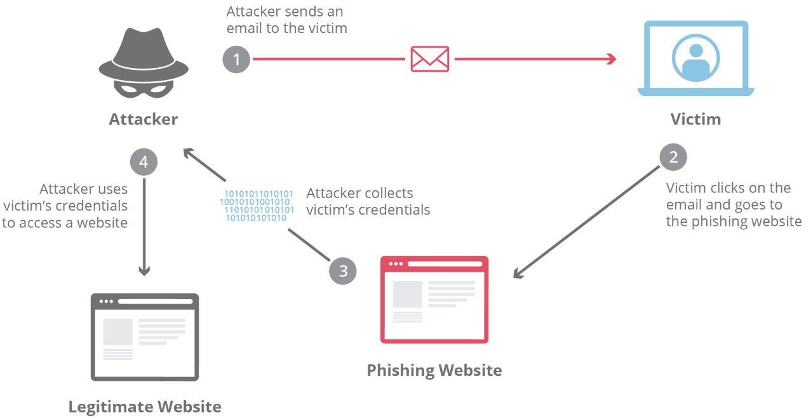
Web Security terminology
Phishing:
“Phishing” refers to an attempt to steal sensitive information, typically in the form of usernames, passwords, credit card numbers, bank account information or other important data in order to utilize or sell the stolen information.
By masquerading as a reputable source with an enticing request, an attacker lures in the victim in order to trick them, similarly to how a fisherman uses bait to catch a fish.
Eg: Advanced-fee scam, Account deactivation scam, Website forgery scam

Slide 49
Web Security terminology
Clickjacking:
Clickjacking is an attack that fools users into thinking they are clicking on one thing when they are actually clicking on another.
Its other name, user interface (UI) redressing, better describes what is going on.
Users think they are using a web page’s normal UI, but in fact there is a hidden UI in control; in other words, the UI has been redressed. When users click something they think is safe, the hidden UI performs a different action.
The attack is possible thanks to HTML frames (iframes), the ability to display web pages within other web pages through frames.
If a web page allows itself to be displayed within a frame, an attacker can cover the original web page with a hidden, transparent layer with its own JavaScript and UI elements.

Slide 50
Web Security terminology
Deepfake:
Deepfakes use AI to generate completely new video or audio, with the end goal of portraying something that didn't actually occur in reality.
The term "deepfake" comes from the underlying technology — deep learning algorithms — which teach themselves to solve problems with large sets of data and can be used to create fake content of real people.
A deepfake would be footage that is generated by a computer that has been trained through countless existing images.
Deepfakes aren't just any fake or misleading images. What separates a deepfake is the element of human input.
There are several methods for creating deepfakes, but the most common relies on the use of deep neural networks that employ a face-swapping technique. You first need a target video to use as the basis of the deepfake and then a collection of video clips of the person you want to insert in the target.

Slide 51
Web Security terminology
Another type of machine learning is added to the mix, known as Generative Adversarial Networks (GANs), which detects and improves any flaws in the deepfake within multiple rounds, making it harder for deepfake detectors to decode them.
As technology improves, the discrepancies between real and fake content will likely become harder to detect.

Slide 52
Web Security terminology
White hat:
White hat hackers (Ethical Hackers) are cybersecurity professionals who are authorized or certified to hack organizational networks and computer systems.
They use their expertise and skills to find vulnerabilities in systems.
Typically, large organizations, businesses, and governments hire white hat hackers to identify security vulnerabilities before black hat hackers can.
White hat hackers spot and fix the weaknesses in the security systems and safeguard them against external attacks and data breaches.
They do not intend to harm a system. Instead, they find loopholes in a system as a part of penetration testing and vulnerability assessments.
Roles and responsibilities of white hat hackers: Identify threats, risks, and weaknesses from open ports, Employing social engineering , Analyzing patch installations, Assessing firewall systems, Protecting networks

Slide 53
Web Security terminology
Black hat:
Black hat hackers (cybercriminals) who find computer security vulnerabilities and exploit them for malicious reasons or financial gain.
They gain unauthorized access to systems and harm their operations or steal sensitive information.
They are knowledgeable computer professionals with the wrong intention.
They have advanced technical knowledge and skills that help them navigate the cybersecurity landscape.
Due to its bad intent, such as damaging the system, stealing sensitive data, violating privacy, etc., black hat hacking is illegal.
They target individual computer users and large organizations to steal sensitive or personal data that can financially compromise a business.
They can also compromise the security of major systems or alter the function of websites and networks.

Slide 54
Web Security terminology
Firewall:
A firewall can be defined as a special type of network security device or a software program that monitors and filters incoming and outgoing network traffic based on a defined set of security rules.
It acts as a barrier between internal private networks and external sources (such as the public Internet).
The primary purpose of a firewall is to allow non-threatening traffic and prevent malicious or unwanted data traffic for protecting the computer from viruses and attacks.
Firewall can be software or hardware.
Firewalls are primarily used to prevent malware and network-based attacks and blocking application-layer attacks.
If a device works without firewall, it will give open access to other networks, made device vulnerable to malicious software.
Face Lost or compromised data or in some times network crashes.

Slide 55
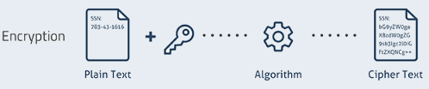
Web Security terminology
Encryption and Decryption:
Cryptography is used to secure and protect data during communication.
It is helpful to prevent unauthorized person or group of users from accessing any confidential data. Encryption and decryption are the two essential functionalities of cryptography.
A message sent over the network is transformed into an unrecognizable encrypted message known as data encryption. At the receiving end, the received message is converted to its original form known as decryption.
Encryption: Encryption is a process which transforms the original information into an unrecognizable form.
This new form of the message is entirely different from the original message. That’s why a hacker is not able to read the data as senders use an encryption algorithm. Encryption is usually done using key algorithms.
Data is encrypted to make it safe from stealing. However, many known companies also encrypt data to keep their trade secret from their competitors.

Slide 56

Web Security terminology
Decryption: Decryption is a process of converting encoded/encrypted data in a form that is readable and understood by a human or a computer.
This method is performed by un-encrypting the text manually or by using keys used to encrypt the original data.
Why Encryption and Decryption:
To protect your confidential data such as passwords and login id
Provides confidentiality of private information
Helps you to ensure that that the document or file has not been altered
Encryption process also prevents plagiarism and protects IP
Helpful for network communication (like the internet) and where a hacker can easily access unencrypted data.
It is an essential method as it helps you to securely protect data that you don’t want anyone else to have access.

Slide 57
Web Security terminology
Types of keys:
Symmetric Key: Symmetric-key encryption are algorithms which use the same cryptographic keys for both encryption of plaintext and decryption of ciphertext.
Asymmetric Key: Asymmetric encryption uses 2 pairs of key for encryption. Public key is available to anyone while the secret key is only made available to the receiver of the message. This boots security.
Public Key: Public key cryptography is an encryption system which is based on two pairs of keys. Public keys are used to encrypt messages for a receiver.
Private Key: Private key may be part of a public/ private asymmetric key pair. It can be used in asymmetric encryption as you can use the same key to encrypt and decrypt data.
Pre-Shared Key: In cryptography, a pre-shared key (PSK) is a shared secret which was earlier shared between the two parties using a secure channel before it is used.

Slide 58
Web Security terminology
Parameter | Encryption | Decryption
What is | It is a process of converting normal data into an unreadable form. | It is a method of converting the unreadable/coded data into its original form.
Process | Whenever the data is sent between two separate machines, it is encrypted automatically using a secret key. | The receiver of the data automatically allows you to convert the data from the codes into its original form.
Location of Conversion | The person who is sending the data to the destination. | The receiver receives the data and converts it.
Example | An employee is sending essential documents to his/her manager. | The manager is receiving the essential documents from his/her employee.
Use of Algorithm | The same algorithm with the same key is used for the encryption-decryption process. | Pair of keys for encryption and decryption

Slide 59
Web Security terminology
Penetration testing:
A penetration test, also known as a pen test, is a simulated cyber attack against your computer system to check for exploitable vulnerabilities.
In the context of web application security, penetration testing is commonly used to augment a web application firewall (WAF).
It can involve the attempted breaching of any number of application systems, (e.g., application protocol interfaces (APIs), frontend/backend servers) to uncover vulnerabilities, such as unsanitized inputs that are susceptible to code injection attacks.
Insights provided by the penetration test can be used to fine-tune your WAF security policies and patch detected vulnerabilities.
There are 5 stages in penetration testing:
1. Planning and reconnaissance: Defining the scope and goals of a test, including the systems to be addressed and the testing methods to be used.
Gathering intelligence (e.g., network and domain names, mail server) to better understand how a target works and its potential vulnerabilities.

Slide 60
Web Security terminology
2. Scanning: is to understand how the target application will respond to various intrusion attempts. This is typically done using:
Static analysis: Inspecting an application’s code to estimate the way it behaves while running, can scan the entirety of the code in a single pass.
Dynamic analysis – Inspecting an application’s code in a running state. This is a more practical way of scanning, as it provides a real-time view into an application’s performance.
3. Gaining Access: This stage uses web application attacks, such as cross-site scripting, SQL injection and backdoors, to uncover a target’s vulnerabilities. Testers exploit these vulnerabilities, typically by escalating privileges, stealing data, intercepting traffic etc., to understand the damage.
4. Maintaining access: The goal of this stage is to see if the vulnerability can be used to achieve a persistent presence in the exploited system— long enough for a bad actor to gain in-depth access. The idea is to imitate advanced persistent threats, which often remain in a system for months in order to steal an organization’s most sensitive data.

Slide 61
Web Security terminology
5. Analysis: The results compiled into a report detailing:
Specific vulnerabilities that were exploited
Sensitive data that was accessed
The amount of time the pen tester was able to remain in the system undetected

